Slide 1
An iOt based health monitoring system
VITALWEAR
GOPAL K - 210701517
SIVANANTHAM D - 210701250
CS19P11 - Internet of things essential

Slide 2
Agenda
Introduction
Existing System
proposed system
Components
Circuit diagram
System Architecture
Output
Future Enhancement
Conclusion

Slide 3
Introduction
VITALWEAR is an integrated device designed to continuously track vital health parameters such as heart rate and blood oxygen levels, along with environmental parameters like temperature and humidity. It leverages an ESP32 microcontroller paired with MAX30100 and DHT11 sensors to provide real-time data and alerts, accessible via the Blynk app.
Functionalities :
Heart Rate Monitoring:
Blood Oxygen Level Monitoring
Temperature and Humidity Monitoring
Remote Monitoring and Alerts
Event Logging
Alerts and notifications

Slide 4
Existing system : fitbit
Disadvantages of Fitbit :
Higher Cost : Fitbit devices are relatively expensive, with prices typically ranging from $100 to $300, making them less accessible to budget-conscious users.
No Environment Monitoring Sensors : Only accessible through Weather API(s).
Lesser Battery Life : Requires frequent charging ,since more features are provided.
Limited Customization : Fitbit's software and hardware are proprietary.
No sensor Misplacement alerts : Fitbit doesn’t produces alerts or notification if the device is not worn correctly or if there is a problem with sensor placement, potentially leading to inaccurate data without user awareness.
No Target Users : Any can who needs to monitor their health can use the device

Slide 5
PROPOSED SYSTEM : VITALWEAr
Advantages of VITALWEAR over FITBIT :
Affordability : VitalWear’s overall making cost is around $10.8 only
Direct Environmental Monitoring : VitalWear directly senses the environmental conditions using Sensors in the device which provides accurate and real-time data without relying on external weather APIs.
Extended Battery Life : Has limited features since it is designed for specific users thus gives better life.
Sensor Placement Alerts: Our system includes alerts for sensor misplacement or issues, ensuring users are aware of any potential inaccuracies in data collection, enhancing the reliability of health monitoring.
Targeted Users - Bedridden Individuals: : Provides a single, convenient solution for monitoring vital health parameters without the need for multiple devices, ensuring ease of use for individuals who may have limited mobility or dexterity.
Peace of Mind for Caregivers: Offers caregivers peace of mind by providing real-time monitoring and alerts for any changes in health parameters, enabling timely interventions and ensuring the well-being of their loved ones.

Slide 6
Components
Hardware Requirements :
ESP 32 Dev Kit
Wi-Fi
DHT Sensor
Max30100 sensor
Micro USB cable
Mobile
Jumper wires
Software Requirements :
Arduino IDE
Blynk App

Slide 7
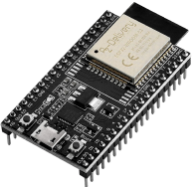
Esp 32
ESP32 is a series of low-cost, low-power system on a chip microcontroller with integrated Wi-Fi and dual-mode Bluetooth.
The ESP32 features a powerful dual-core Xtensa LX6 microprocessor, providing robust computational capabilities suitable for demanding applications.
It has numerous General Purpose Input/Output (GPIO) pins for connecting sensors, LEDs, and other peripherals.

Slide 8
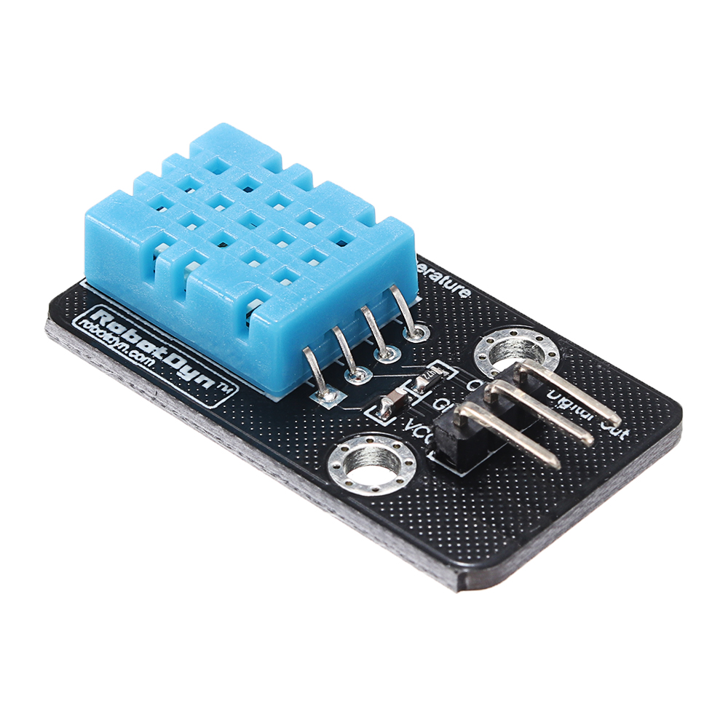
DHT11 Sensor
Environmental Monitoring: DHT11 sensor measures both temperature and humidity, providing essential data about the surrounding environment.
High Accuracy and Reliability: It offers accurate readings with a temperature measurement range of 0-50°C and a humidity range of 20-90%, making it reliable for various applications.
Ease of Integration: The DHT11 is easy to integrate into IoT projects and systems due to its simple interface and compatibility with microcontrollers and development boards like Arduino and Raspberry Pi.

Slide 9
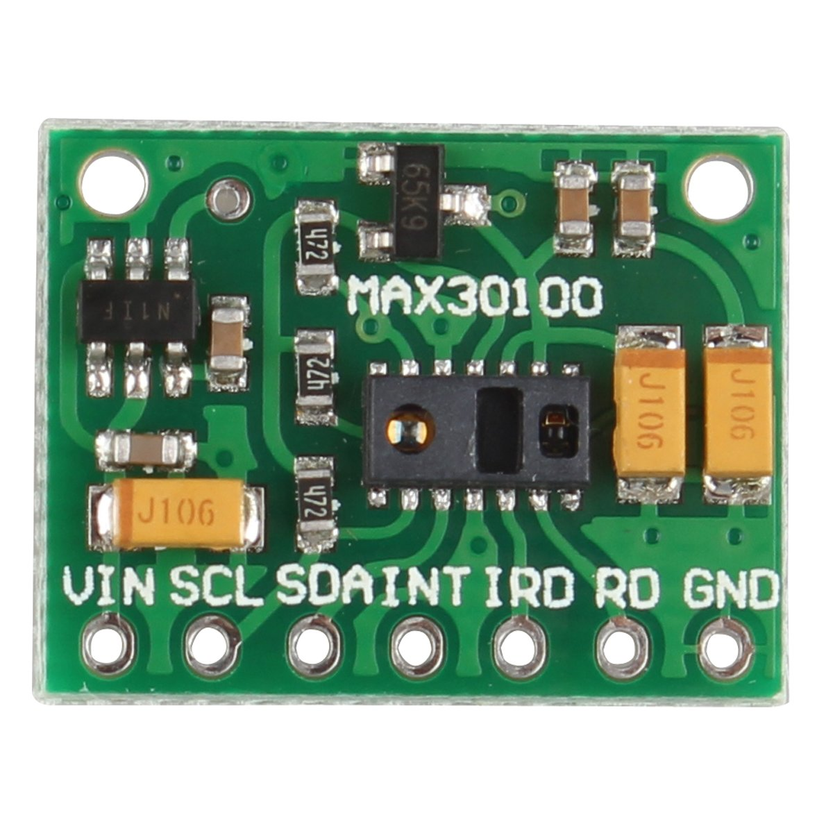
MAX30100 sensor
Vital Health Monitoring: The heart rate sensor measures the pulse rate, providing critical information about cardiovascular health and detecting potential irregularities such as arrhythmias.
Real-Time Data: It offers real-time monitoring of heart rate, enabling continuous tracking of an individual's cardiovascular condition and facilitating immediate alerts in case of abnormal readings.
Oxygen Saturation Measurement: Measures the oxygen saturation levels in the blood, providing essential information about respiratory function and overall oxygen levels.
Critical Health Indicator: Helps detect conditions such as hypoxemia and other respiratory issues, offering real-time data that can be crucial for immediate medical intervention and ongoing health monitoring.

Slide 10
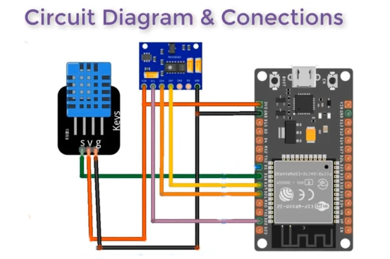
Circuit Diagram

Slide 11
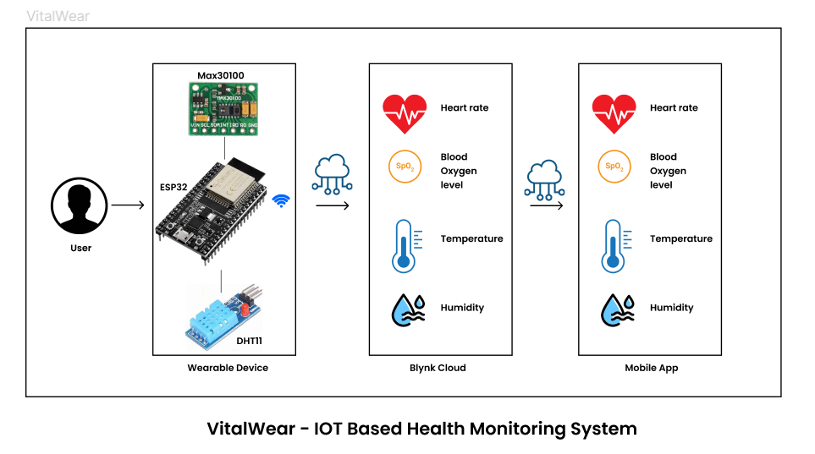
SYSTEM ARCHITECTURE

Slide 12
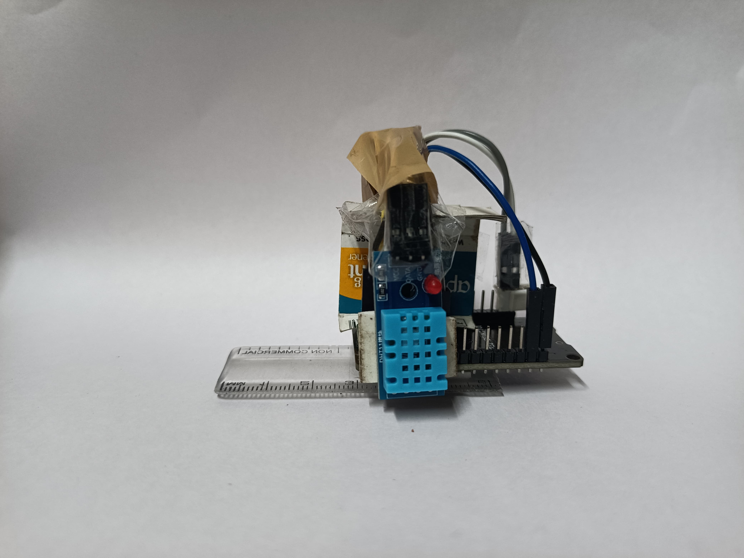
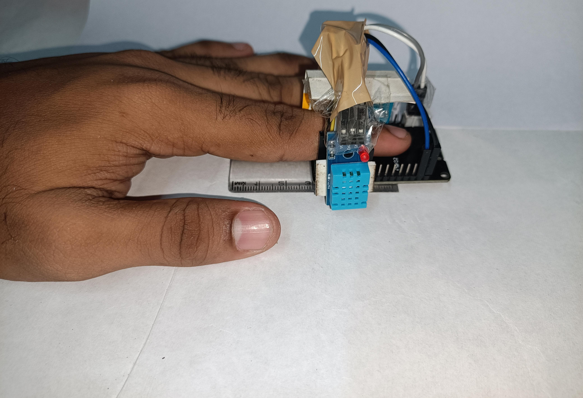
vitalwear

Slide 13
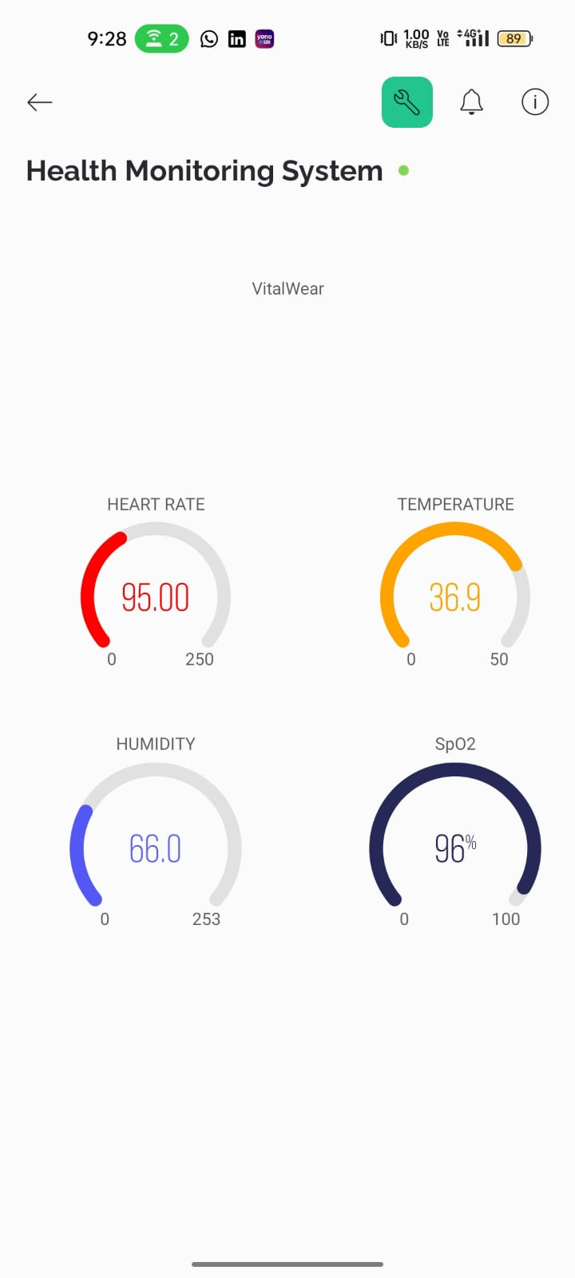
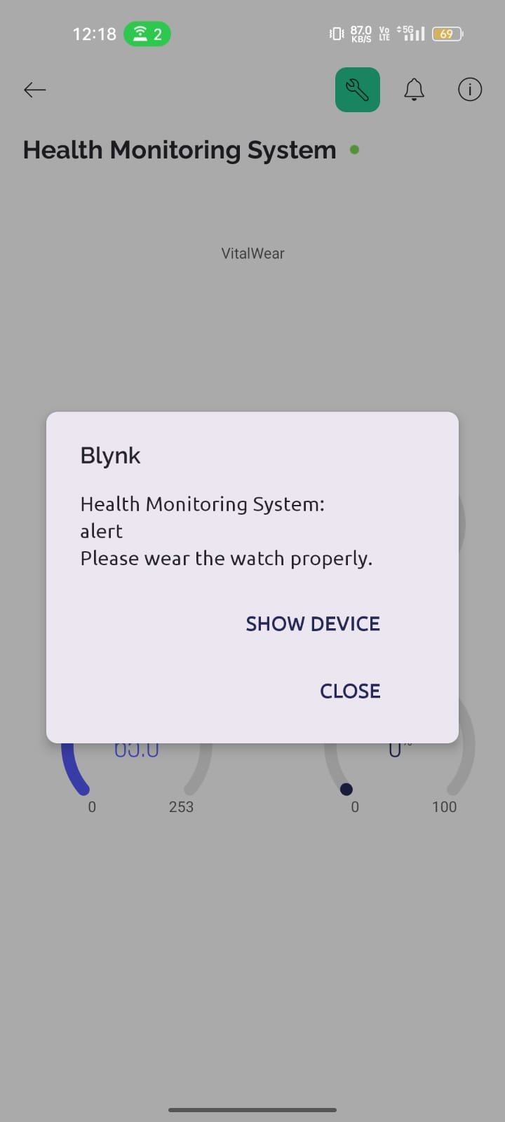
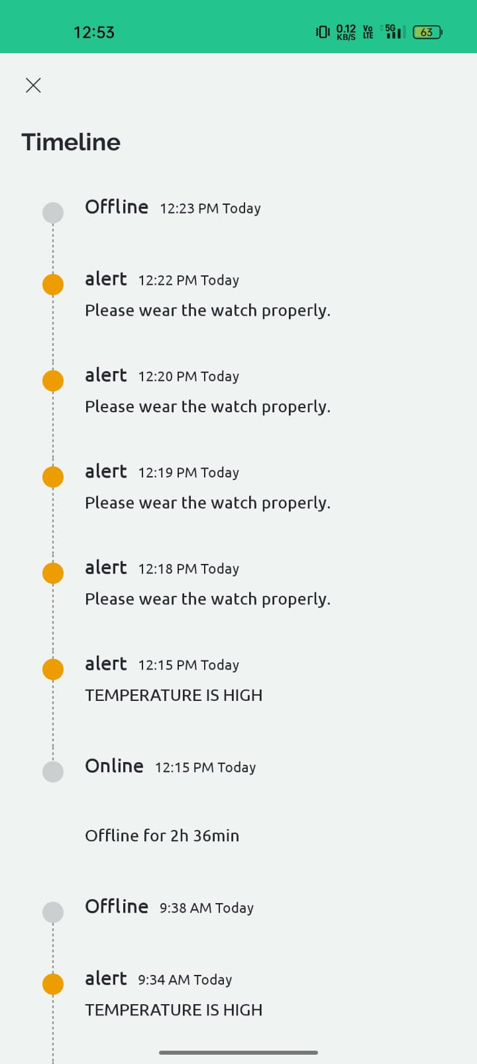
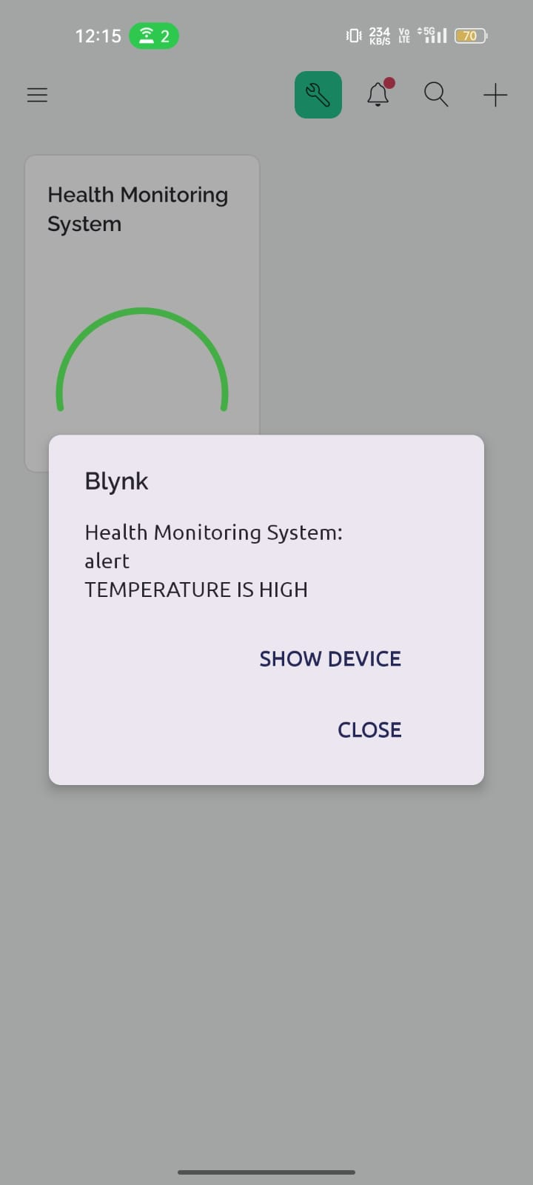
output

Slide 14
Future enhancement
Machine Learning and Predictive Analytics: Implement machine learning algorithms and advanced data analytics techniques to analyze the collected health data. This could enable the system to identify patterns, trends, and anomalies in the data, offering predictive insights into potential health issues and personalized health recommendations for users.
User Interface Improvements: Continuously improve the user interface of the Android application to enhance usability, accessibility, and user experience. This could involve implementing user feedback mechanisms, customizing notifications based on user preferences, and incorporating features for visualizing and interpreting health data more effectively.

Slide 15
conclusion
VitalWear leverages IoT technology to enable continuous and thorough health monitoring, empowering individuals to take charge of their health proactively.
Through the integration of advanced sensors and the Blynk IoT platform, Vitalwear provides timely notifications for abnormal sensor readings or improper sensor usage, facilitating prompt action to prevent potential health problems.
The project sets the stage for future enhancements such as expanded sensor integration, advanced data analytics, and cloud integration for improved health monitoring and personalized care management.

Slide 16
Your Health , Our Priority
Thank You

